Slide 1
RATING PREDICTION

Slide 2
PROBLEM STATEMENT:
We have a client who has a website where people write different reviews for technical products. Now they are adding a new feature to their website i.e. The reviewer will have to add stars(rating) as well with the review. The rating is out 5 stars and it only has 5 options available 1 star, 2 stars, 3 stars, 4 stars, 5 stars. Now they want to predict ratings for the reviews which were written in the past and they don’t have a rating. So, we have to build an application which can predict the rating by seeing the review.

Slide 3
Business Goal:
After collecting the data, you need to build a machine learning model. Before model building do all data pre-processing steps. Try different models with different hyper parameters and select the best model.
Follow the complete life cycle of data science. Include all the steps like.
1. Data Cleaning
2. Exploratory Data Analysis
3. Data Pre-processing
4. Model Building
5. Model Evaluation
6. Selecting the best model

Slide 4
Technical Requirements:
Data needs to be collected from online ecommerce websites.
Data contains Null values. You need to treat them using the domain knowledge and your own understanding
Data needs to be pre processed using Regex.
You have to build Machine Learning models, apply regularization and determine the optimal values of Hyper Parameters.

Slide 5
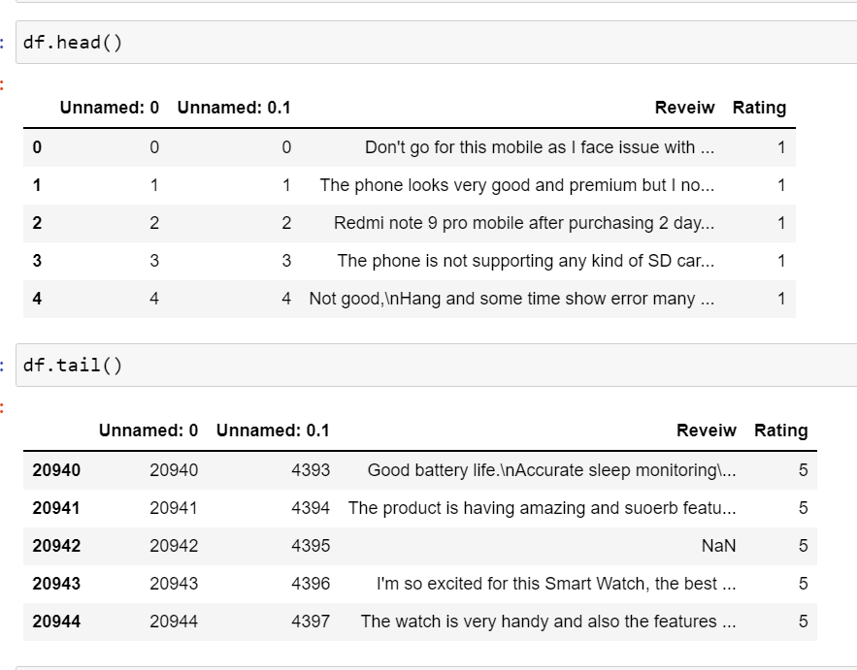
ABOUT THE DATASET:
Using various methods like df.shape, df.columns, df.head(), df.tail() , df.info() to get some idea about the data we are handling

Slide 6
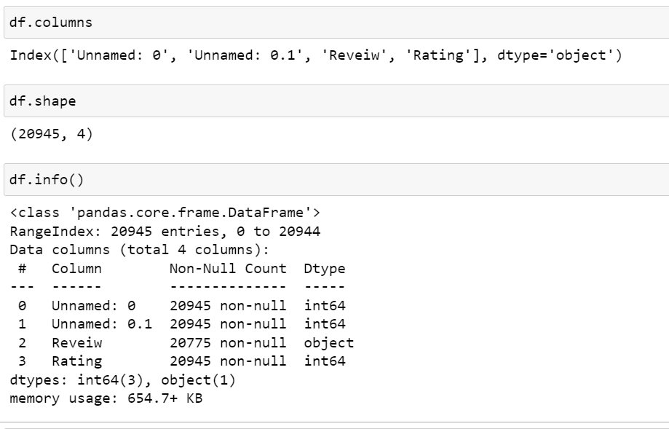
ABOUT THE DATASET:

Slide 7
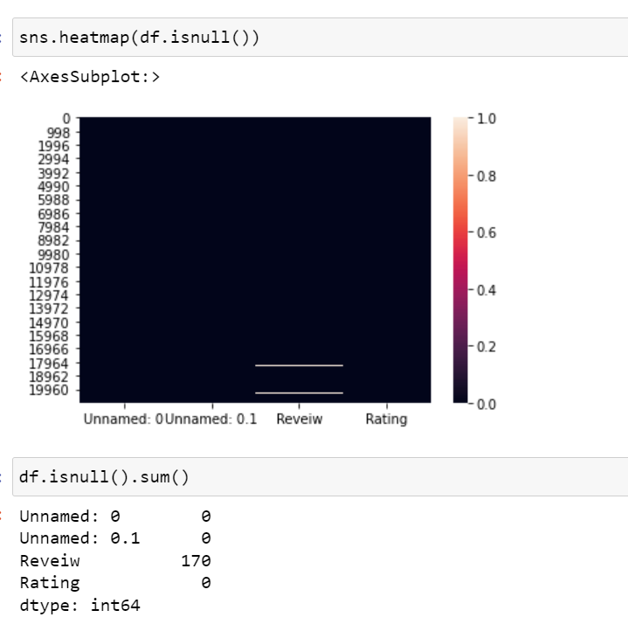
NULL VALUE CHECK:
Checking null values present in data by heatmap

Slide 8
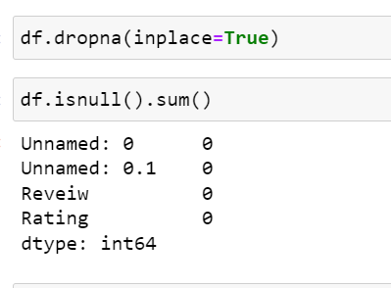
NULL VALUE TREATMENT:
Null values are removed

Slide 9
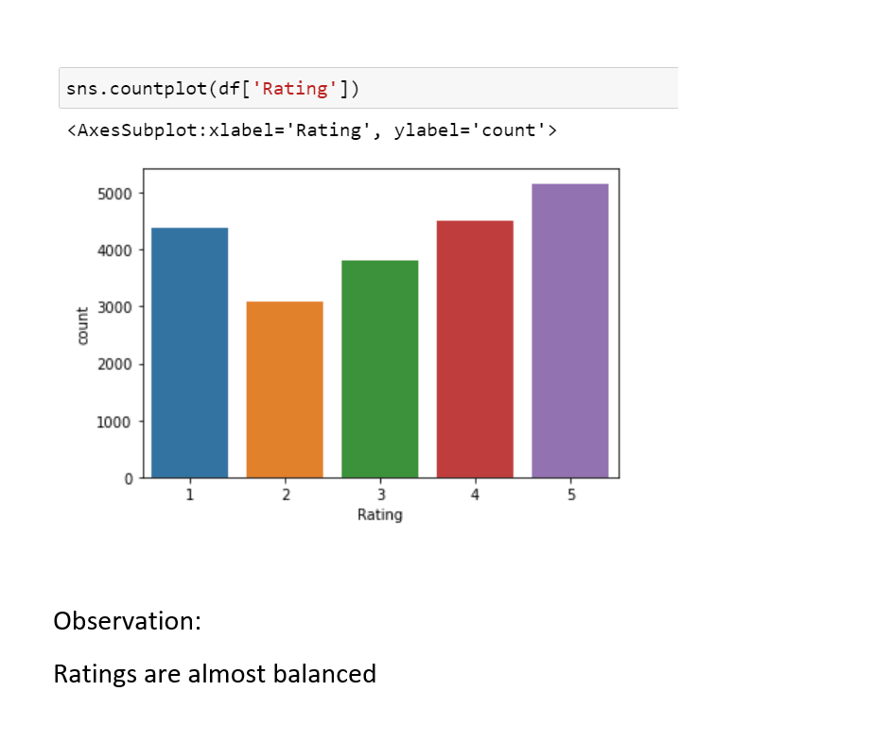
VISUALIZATIONS :

Slide 10
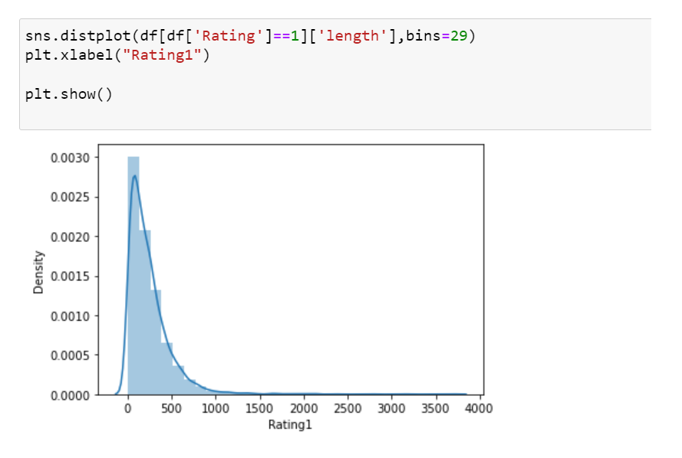
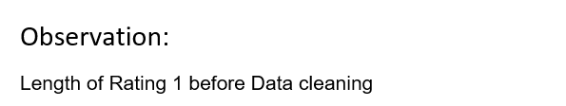
VISUALIZATIONS :

Slide 11
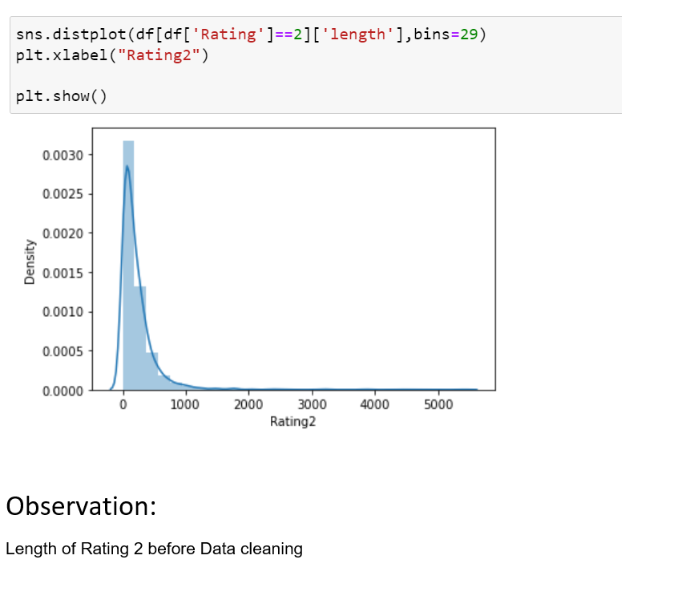
VISUALIZATIONS :

Slide 12
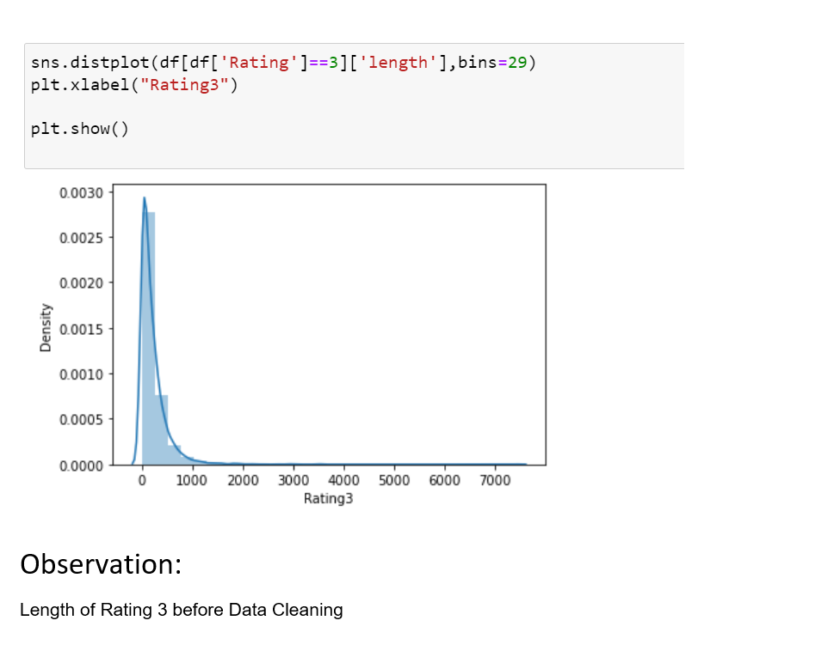
VISUALIZATIONS :

Slide 13
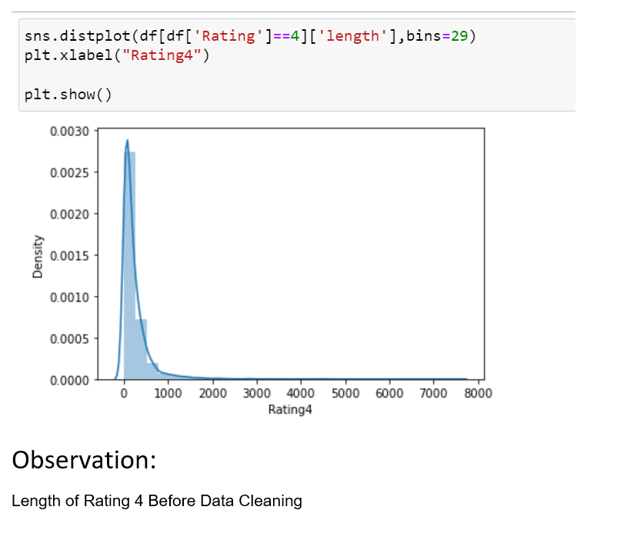
VISUALIZATIONS :

Slide 14
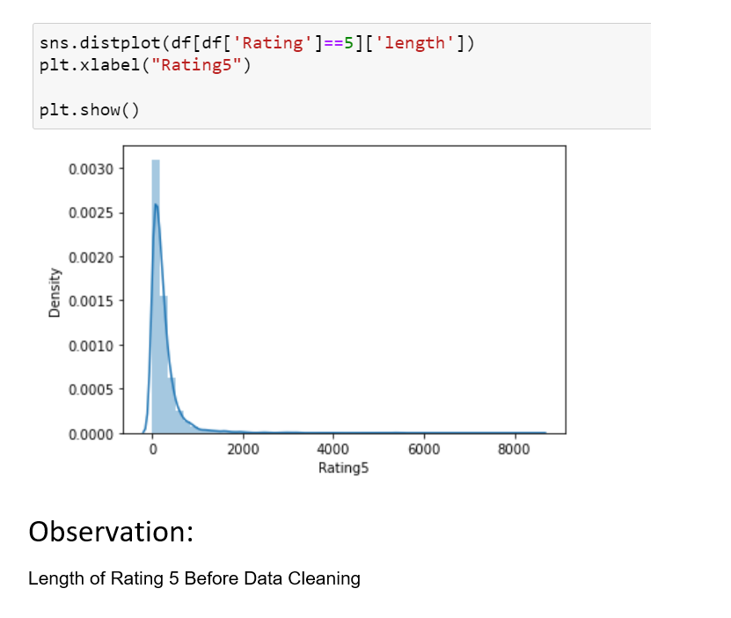
VISUALIZATIONS :

Slide 15
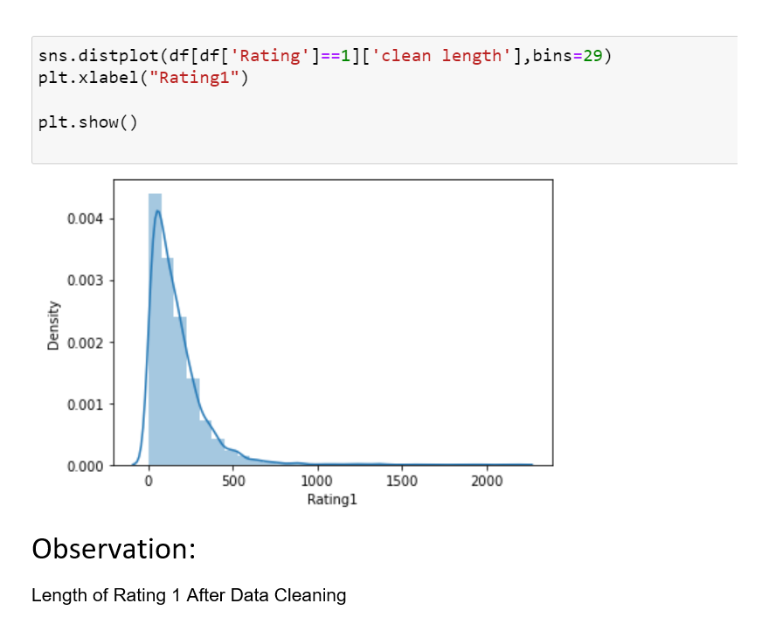
VISUALIZATIONS :

Slide 16
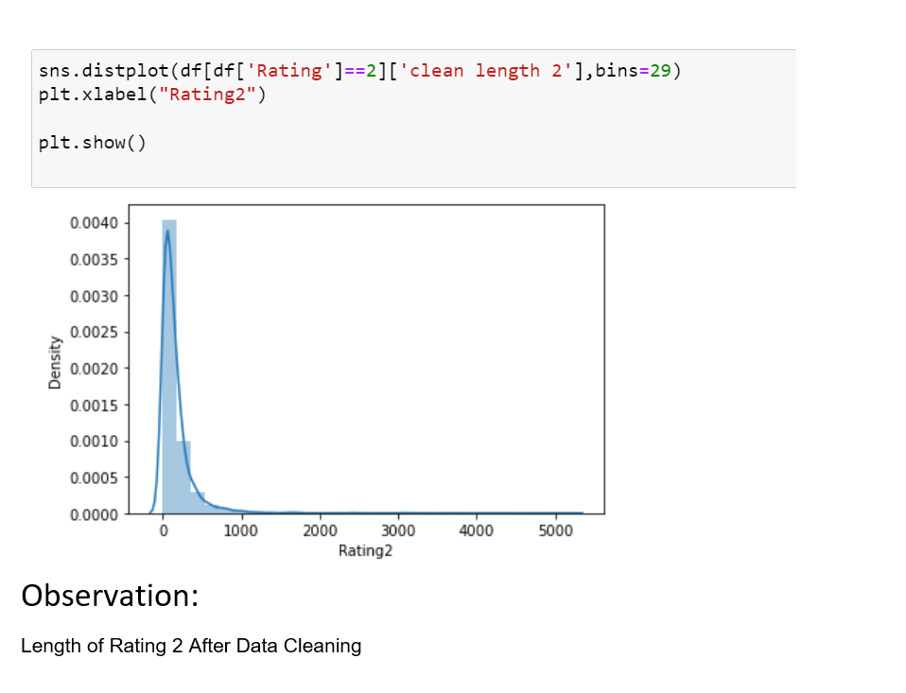
VISUALIZATIONS :

Slide 17
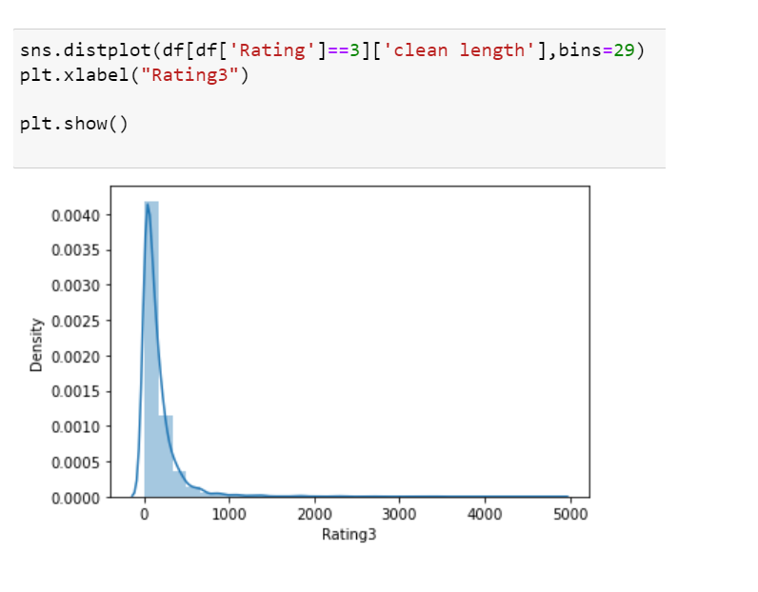
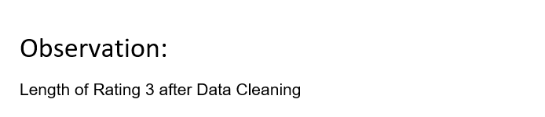
VISUALIZATIONS :

Slide 18
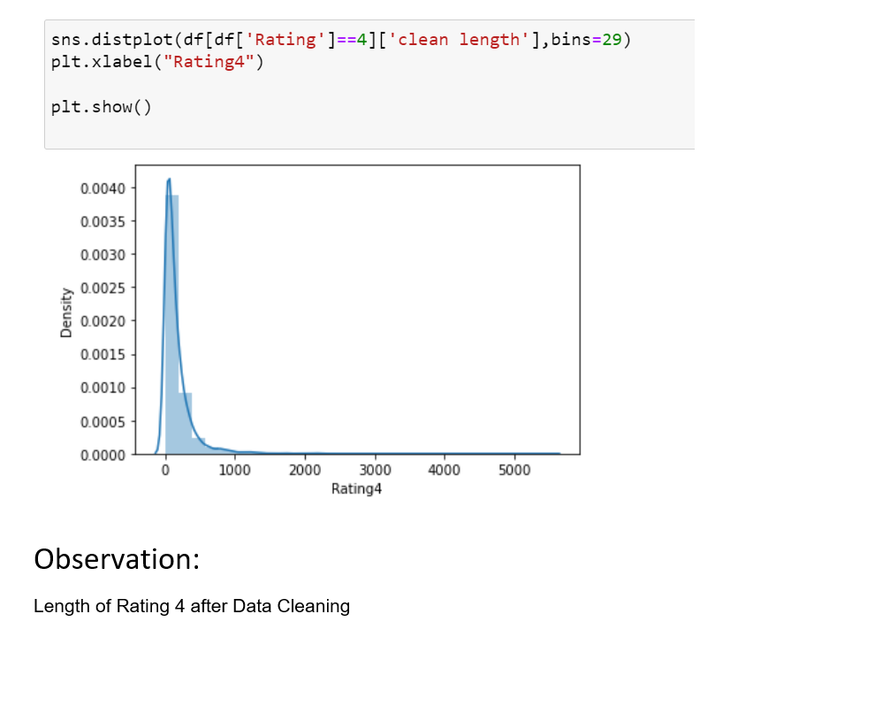
VISUALIZATIONS :

Slide 19
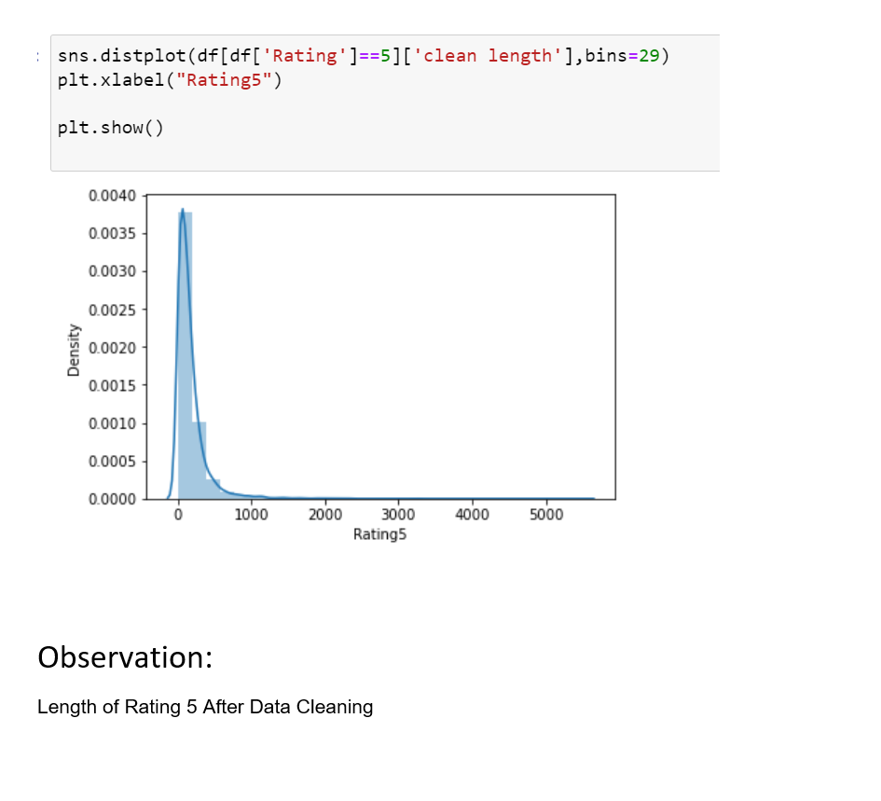
VISUALIZATIONS :

Slide 20
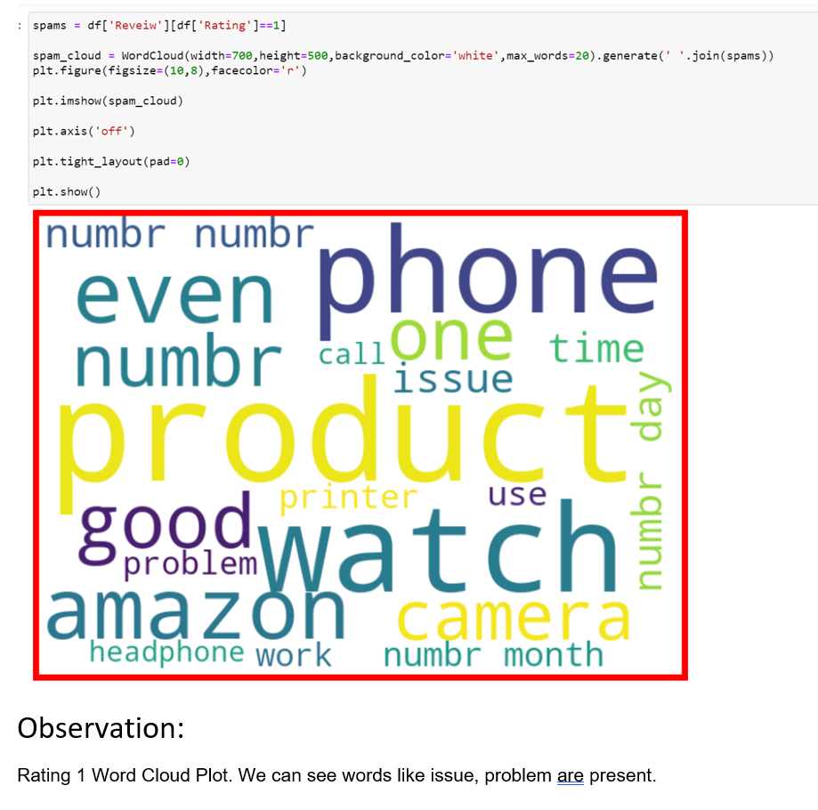
VISUALIZATIONS :

Slide 21
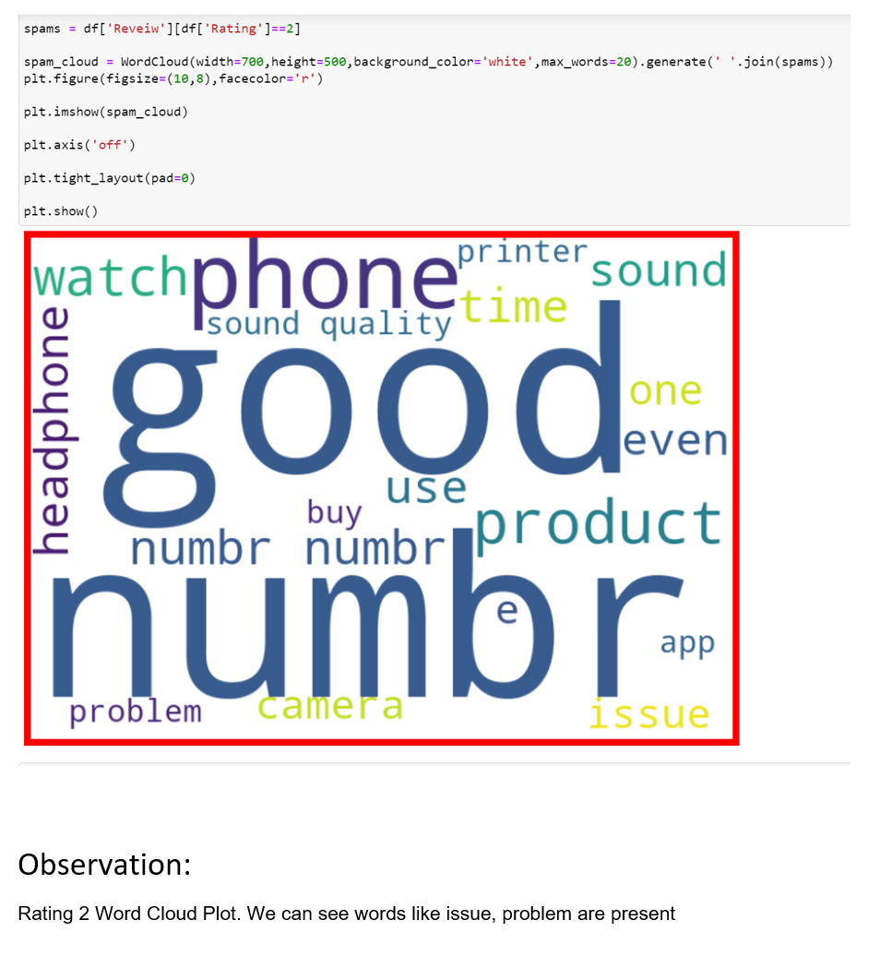
VISUALIZATIONS :

Slide 22
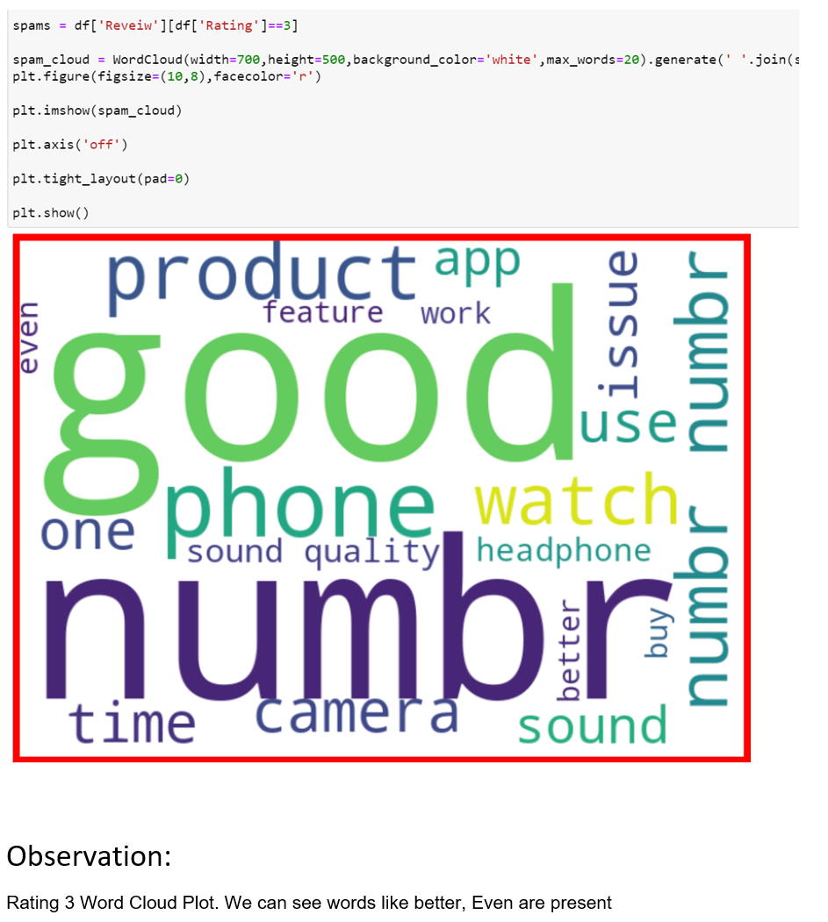
VISUALIZATIONS :

Slide 23
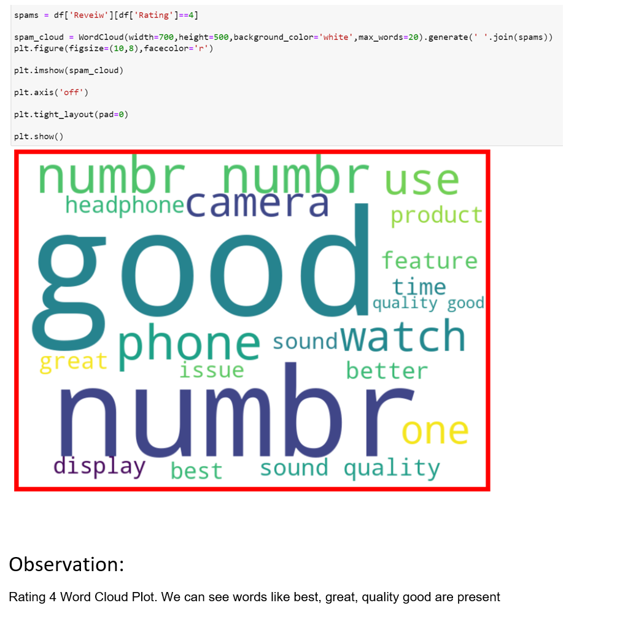
VISUALIZATIONS :

Slide 24
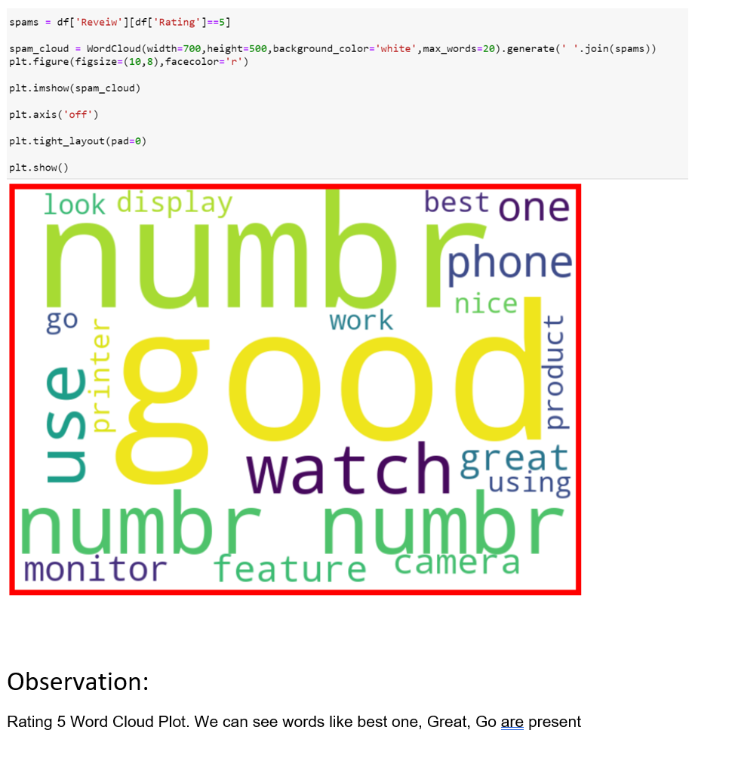
VISUALIZATIONS :

Slide 25
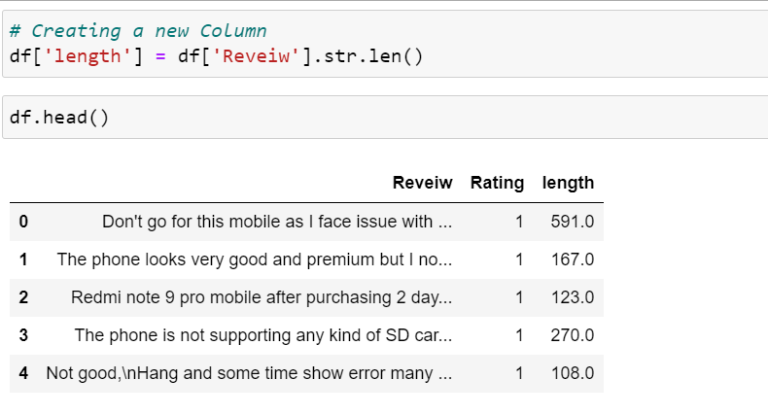
Data Pre-processing Done

Slide 26
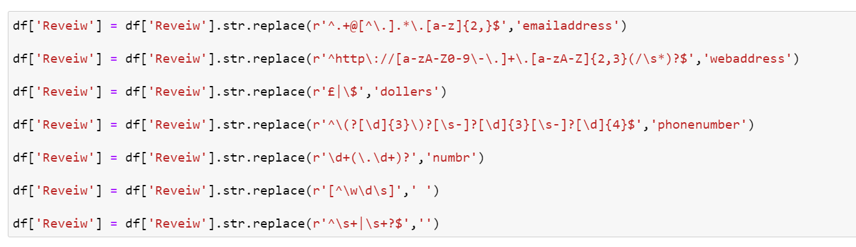
Data Pre-processing Done

Slide 27
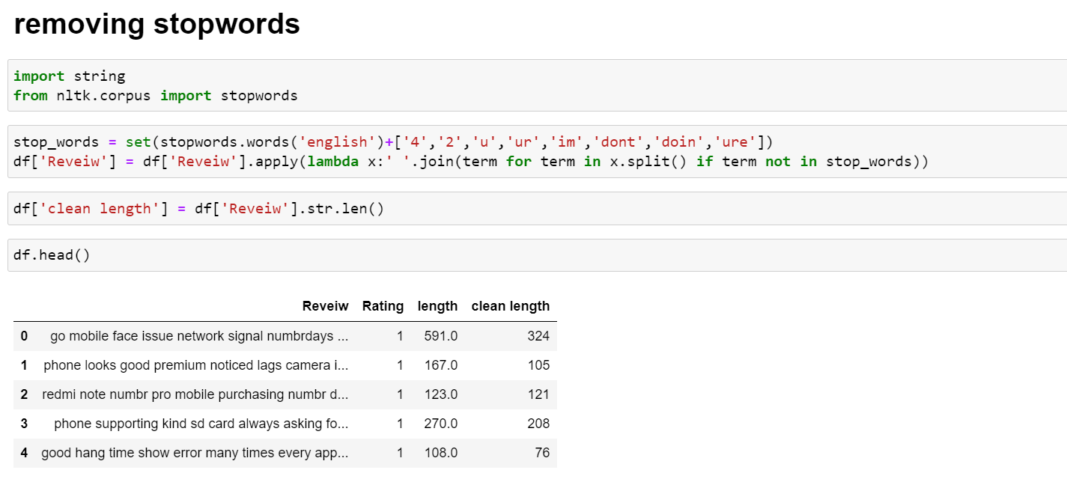
Data Pre-processing Done

Slide 28
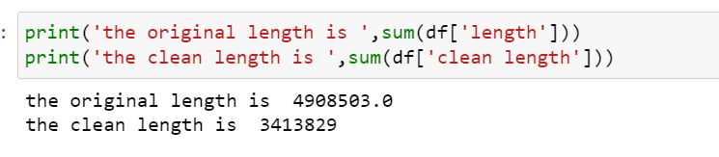
Data Pre-processing Done

Slide 29
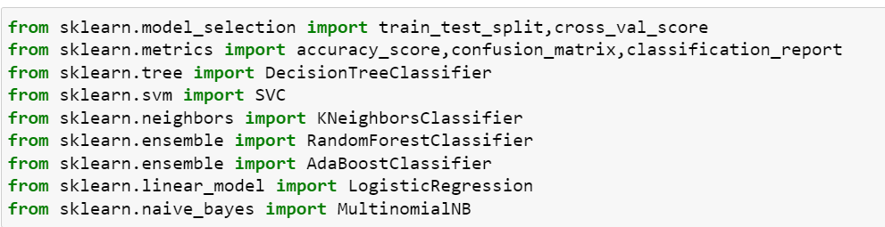
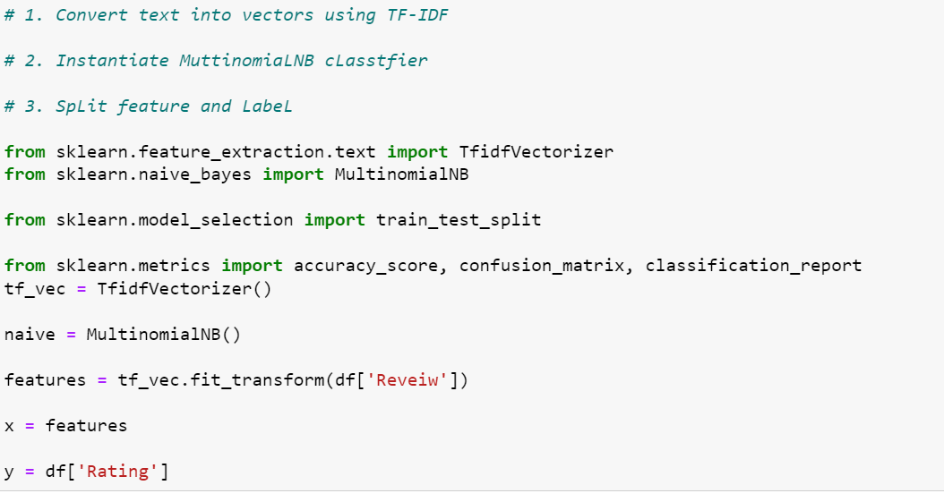
MODEL TRAINING

Slide 30
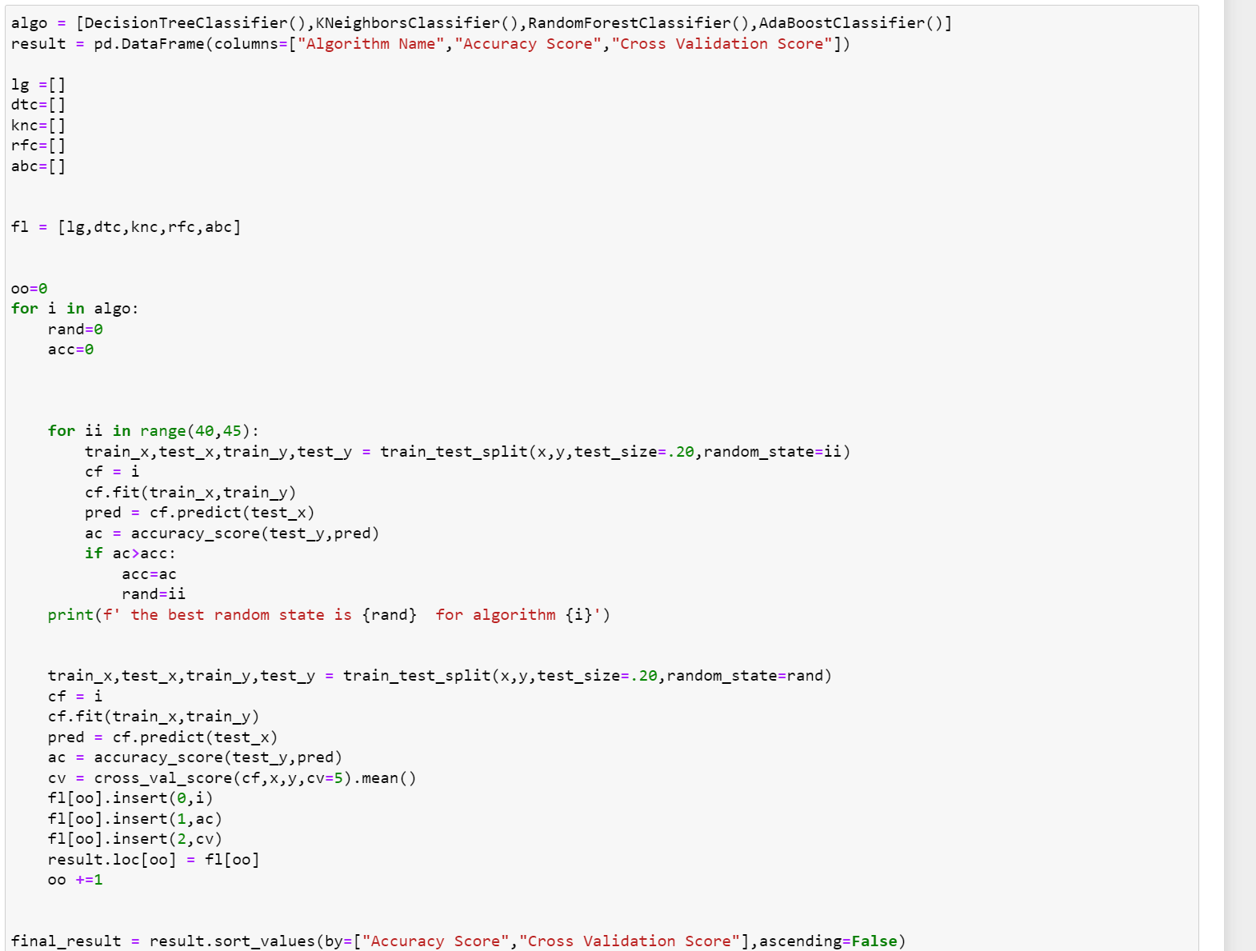
MODEL TRAINING
This code block runs and ranks the best algorithm

Slide 31
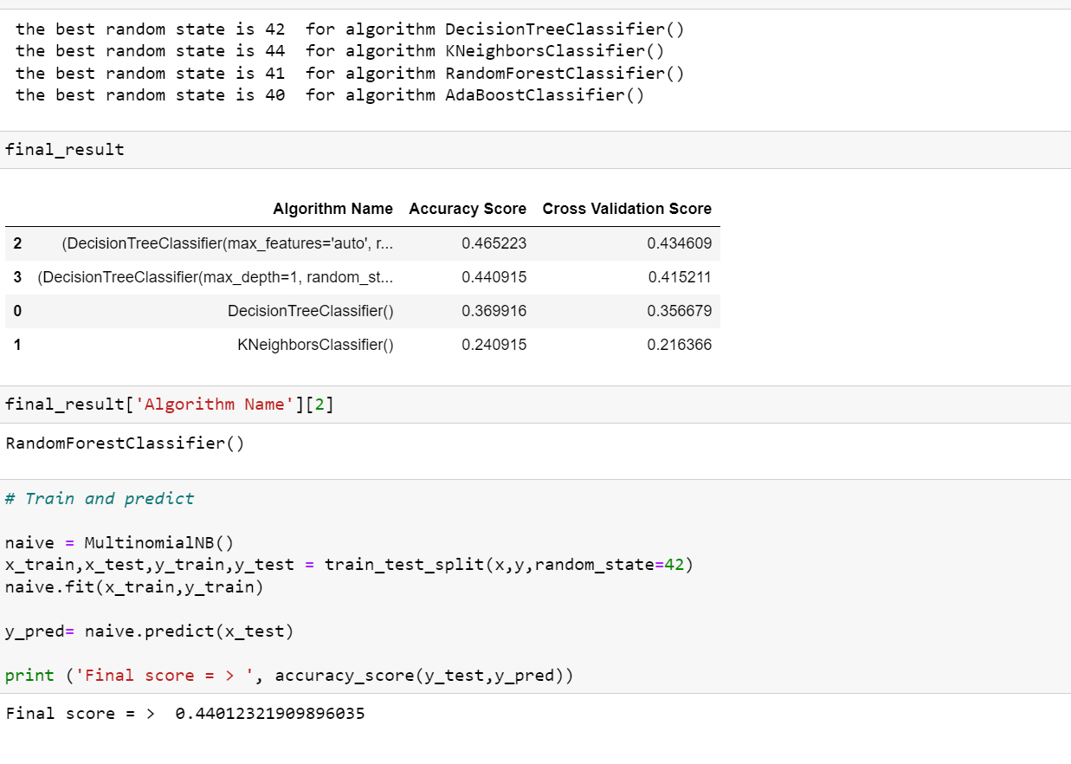
MODEL TRAINING
We can see random forest Classifier performed best compared to other algorithms

Slide 32
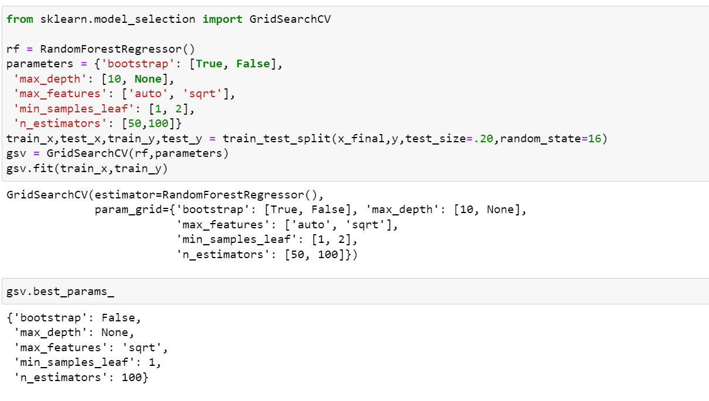
HYPERPARAMETER TUNING

Slide 33
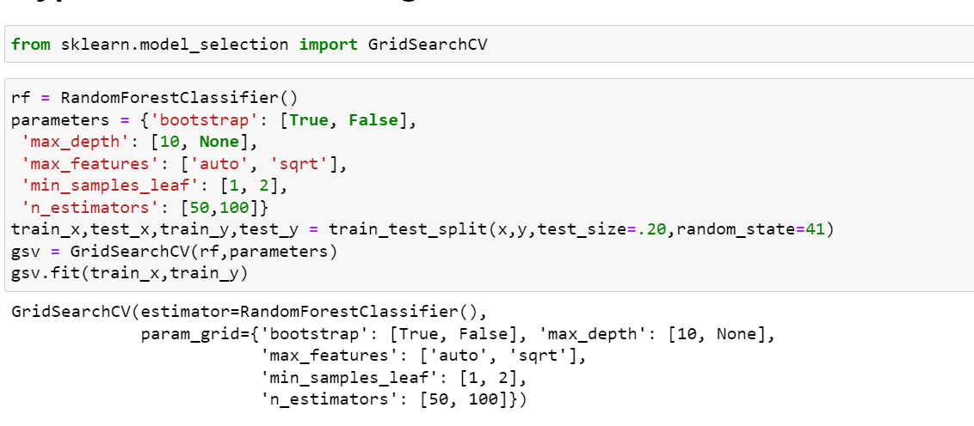
HYPERPARAMETER TUNING

Slide 34
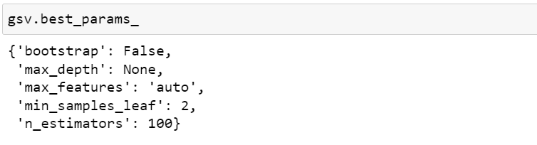
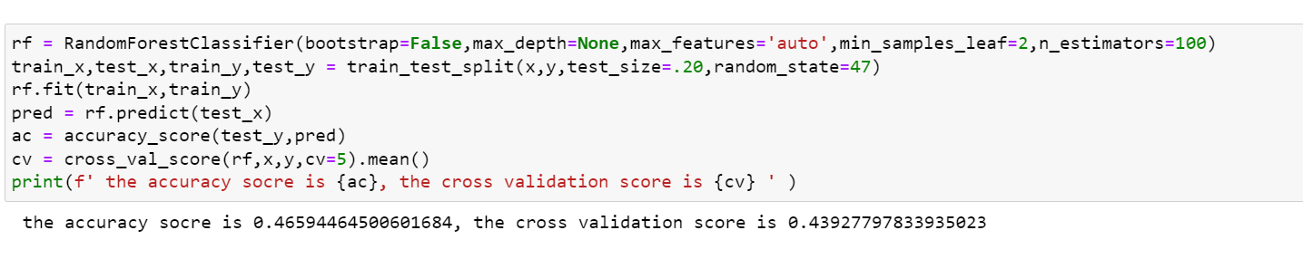
HYPERPARAMETER TUNING

Slide 35
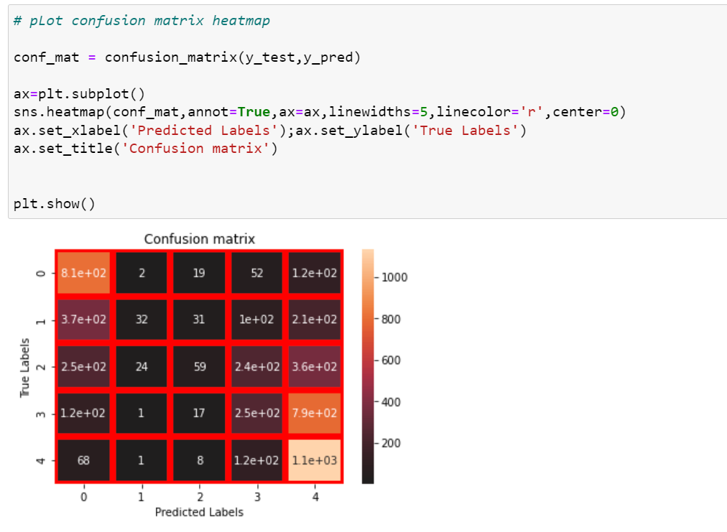
EVALUATION METRICS

Slide 36
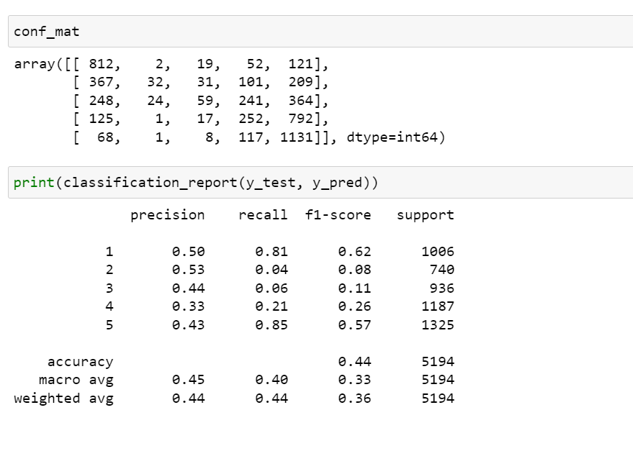
EVALUATION METRICS

Slide 37
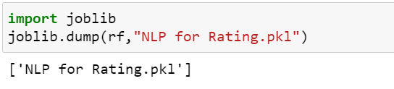
SAVING THE MODEL

Slide 38
CONCLUSION
Key Findings and Conclusions of the Study
We can clearly see that Certain words affect the rating prediction of the NLP Program.
Learning Outcomes of the Study in respect of Data Science
We can learn many useful insights from this study. the words people most often use to criticize as well as praise the products. So based on these words NLP process the Rating Prediction.
Limitations of this work and Scope for Future Work
The Limitations are Data collection are less. in future massive dataset is needed to get more accurate model

Slide 39
THANK YOU FOR THE OPPORTUNITY :

